Slide 1
K-Means
An unsupervised CLUSTERING algorithm
By:
Vishal Chawan - 1MS16IS116
Yash Khakhar - 1MS16IS120

Slide 2
Introduction to clustering
Clustering is one of the most common exploratory data analysis technique used to get an intuition about the structure of the data. It can be defined as the task of identifying subgroups in the data such that data points in the same subgroup (cluster) are very similar while data points in different clusters are very different.

Slide 3
Introduction to K-Means
Kmeans algorithm is an iterative algorithm that tries to partition the dataset into K pre-defined distinct non-overlapping subgroups (clusters) where each data point belongs to only one group. It tries to make the inter-cluster data points as similar as possible while also keeping the clusters as different (far) as possible

Slide 4
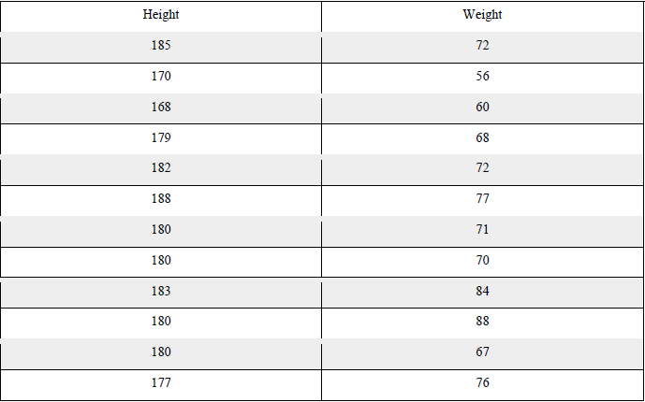
Problem Statement
Apply K-Means on the following dataset and cluster the data into two clusters, using Euclidean Distance

Slide 5
The ALGORITHM
Specify number of clusters K.
Initialize centroids by first shuffling the dataset and then randomly selecting K data points for the centroids without replacement.
Keep iterating until there is no change to the centroids. i.e assignment of data points to clusters isn’t changing

Slide 6
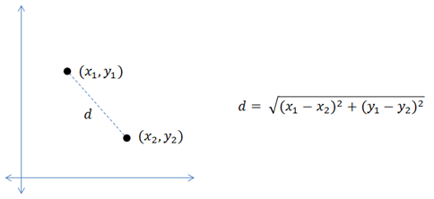
Euclidean Distance

Slide 7
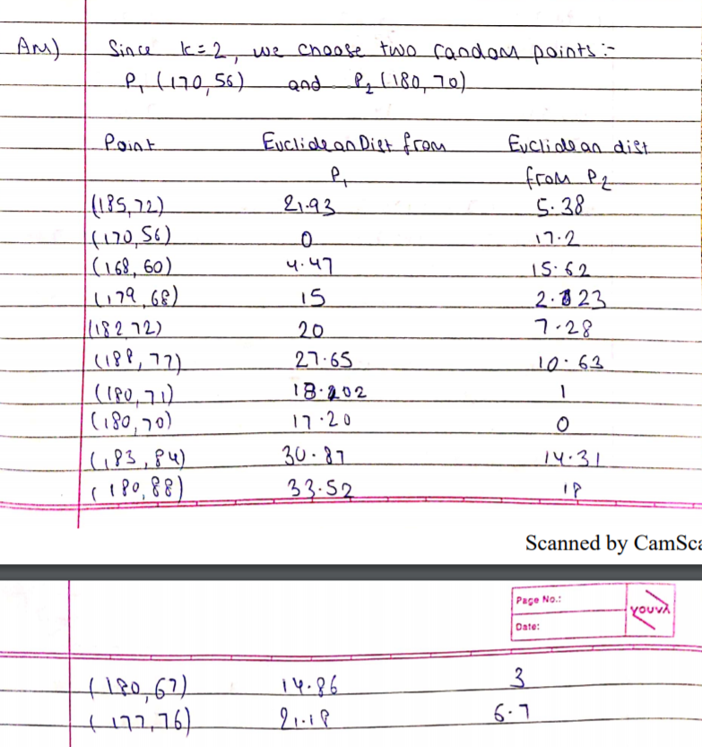
Pen-Paper Solution

Slide 8
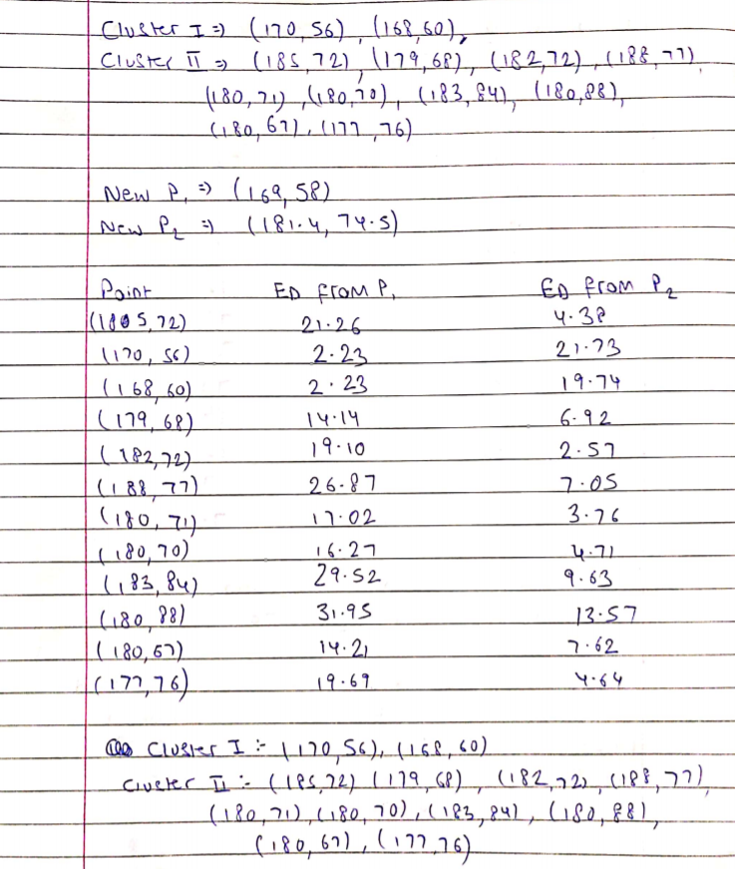

Slide 9
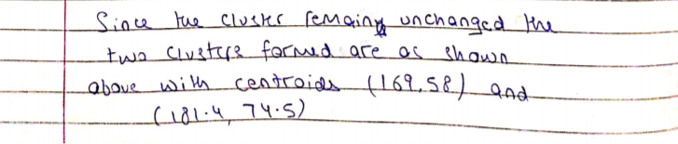

Slide 10
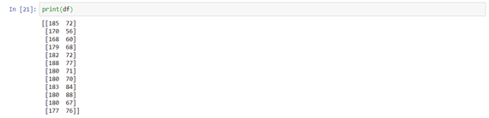
Computer Implementation with 500 iterations

Slide 11
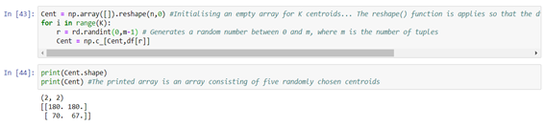
Generating two random centroids

Slide 12
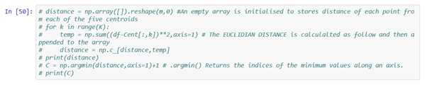
Calculating distance of each point from the generated centroids

Slide 13
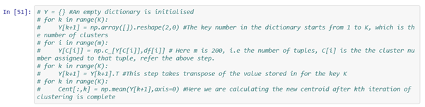
Classifies the points by making a dictionary, wherein the key is the cluster number and value for that key is the array of elements which belong to that cluster

Slide 14
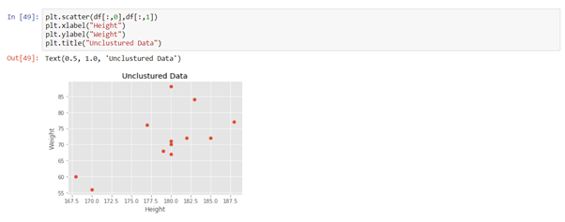
Visualisation
Unclustered Data

Slide 15
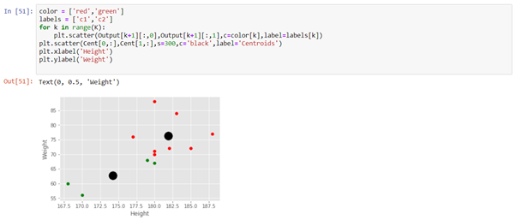
Clustered Data

Slide 16
Bibliography
https://medium.com/machine-learning-algorithms-from-scratch/k-means-clustering-from-scratch-in-python-1675d38eee42
https://scikit-learn.org/stable/modules/generated/sklearn.cluster.KMeans.html
https://pythonprogramming.net/k-means-from-scratch-machine-learning-tutorial/

